Slide 1
The Software Process

Slide 2
The Software Process
Process
A process is a collection of activities, actions, and tasks that are performed when some work product is to be created.
The Software Process
A structured set of activities required to develop a software system.
A software process model is an abstract representation of a process. It presents a description of a process from some particular perspective.

Slide 3
The Software Process
An activity strives to achieve a broad objective (e.g., communication with stakeholders) and is applied regardless of the application domain, size of the project, complexity of the effort, or degree of rigor with which software engineering is to be applied (group of related tasks and actions for a major objective).
An action (e.g., architectural design) encompasses a set of tasks that produce a major work product (e.g., an architectural design model).
A task focuses on a small, but well-defined objective (e.g., conducting a unit test) that produces a tangible outcome.

Slide 4
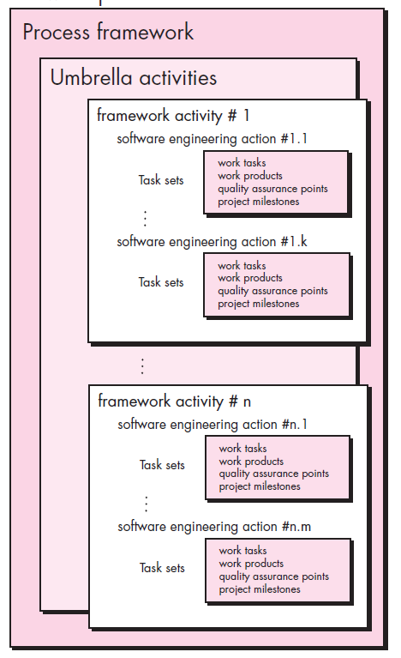
Generic Software Process Framework

Slide 5
The Generic Software Process Activities
Communication
Planning
Deployment
Software Process Activities
Construction
Modeling

Slide 6
Process Framework Activities
Communication – Communicate with stakeholders and customers to obtain objectives of the system and requirements for the software.
Planning – The software project plan has details of resources needed, tasks and risk factors likely to occur, and schedule.
Modelling – Architectural models and design to better understand the problem and work towards the best solution.
Construction – Generation of code and testing of the system to rectify errors and ensure all specified requirements are met.
Deployment – Entire software product or partially completed product is delivered to the customer for evaluation and feedback.

Slide 7
Many different Software Processes But All Involve
Specification – defining what the system should do;
Design and implementation – defining the organization of the system and implementing the system;
Validation – checking that it does what the customer wants;
Evolution – changing the system in response to changing customer needs

Slide 8
Umbrella Activities
Work product preparation and production
Reusability management
Software project tracking and control
Umbrella Activities
Software Configuration Management (SCM)
Risk management
Measurement
Technical reviews
Software quality assurance (SQA)

Slide 9
Umbrella Activities
Software project tracking and control – Compare the progress of the project with the plan and take steps to maintain a planned schedule.
Risk management – Evaluate risks that can affect the outcome and quality of the software product.
Software quality assurance (SQA) – Conduct activities to ensure the quality of the product.
Technical reviews – Assessment of errors and corrections done at each stage of activity.
Measurement – All the measurements of the project and product features.
Software configuration management (SCM) – Controlling and tracking changes in the software.
Reusability management – Back up work products for reuse and apply the mechanism to achieve reusable software components.
Work product preparation and production – Project planning and other activities used to create work products are documented.

Slide 10
Software development Process flow
Process flow determines how activities, actions and tasks are arranged with respect to sequence and time.
Linear process flow
Linear process flow executes each activity in sequence.

Slide 11
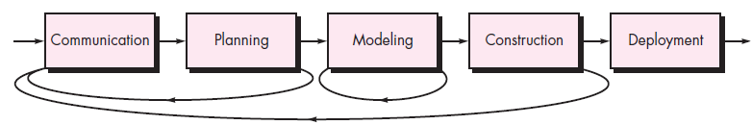
Software development Process flow Cont’d
Iterative process flow
Iterative process flow repeats one or more activities before starting next.

Slide 12
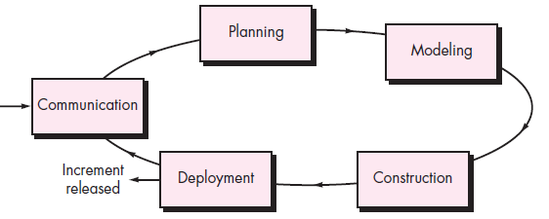
Software development Process flow Cont’d
Evolutionary process flow
Evolutionary process flow carries out activities in a circular way.

Slide 13
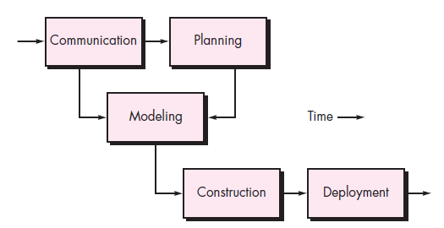
Software development Process flow Cont’d
Parallel process flow
Parallel process flow executes one or more activities in parallel with each other.

Slide 14
Defining a framework activity
Consider communication activity. For a small project, this can be defined as having tasks set:
Making a phone call with stakeholders.
Discuss requirements and note them down.
Organize requirements.
Mail stakeholders for review and approval.
For large projects, this may have extended actions such as feasibility study, elicitation of requirements, elaboration of requirements, specification documents, validation etc.

Slide 15
Identifying a task set
Task set is the actual work to be done to achieve an objective of engineering action.
For a small project, consider elicitation action in communication activity, this may include.
Prepare a list of stakeholders of the project.
Organize a meeting for stakeholders.
Discuss requirements.
Finalize requirements list.
Make a list of issues raised.
For large projects, extraneous steps may be added to elicitation such as interviewing each stakeholder separately before the group meeting, more techniques applied in discussing requirements…etc.

Slide 16
Process patterns
Process patterns are patterns used to describe problems and their solutions in the context of software processes.
Problems can arise at different levels such as :
Problems associated with a complete process model
Within a framework activity
Within an action in an activity

Slide 17
Process Pattern Template
Pattern name
Intent (describes process pattern in one or two paragraphs)
Forces and Types (environment in which problem is encountered is identified and the type of pattern is specified)
Stage pattern – explains problems related to framework activity and it may include multiple task patterns as well.
Example: ‘Establishing Communication’ (stage pattern) includes ‘Requirements Gathering'(task pattern)
Task pattern – describes problems related to software engineering action or task such as Requirements Gathering.
Phase pattern – defines a sequence of framework activities and ensures each section in the activity is addressed correctly such as in prototyping, spiral model etc.
Initial context – Situation to which the pattern is applied. Defines work done so far before the pattern is applied. Actions and activities that have taken place before the pattern is introduced.
Problem – Specific problem that is to be solved by the pattern.
Solution – Implements pattern and initial context is modified to resolve the problem.
Resulting context – Situation which will result from carrying out the process pattern solution.
Related patterns – A list of patterns related to the current one is documented for further reference.
Known uses or examples – Indicates where or how the process pattern is applicable.

Slide 18
Process Assessment and Improvement
Standard CMMI Assessment Method for Process Improvement (SCAMPI)
—provides a five-step process assessment model that incorporates five phases: initiating, diagnosing, establishing, acting and learning.
CMM-Based Appraisal for Internal Process Improvement (CBA IPI)
—provides a diagnostic technique for assessing the relative maturity of a software organization; uses the SEI CMM as the basis for the assessment [Dun01]
SPICE
—The SPICE (ISO/IEC15504) standard defines a set of requirements for software process assessment. The standard intends to assist organizations in developing an objective evaluation of the efficacy of any defined software process. [ISO08]
ISO 9001:2000 for Software
—A generic standard that applies to any organization that wants to improve the overall quality of the products, systems, or services that it provides. Therefore, the standard is directly applicable to software organizations and companies. [Ant06]

